Slide 1
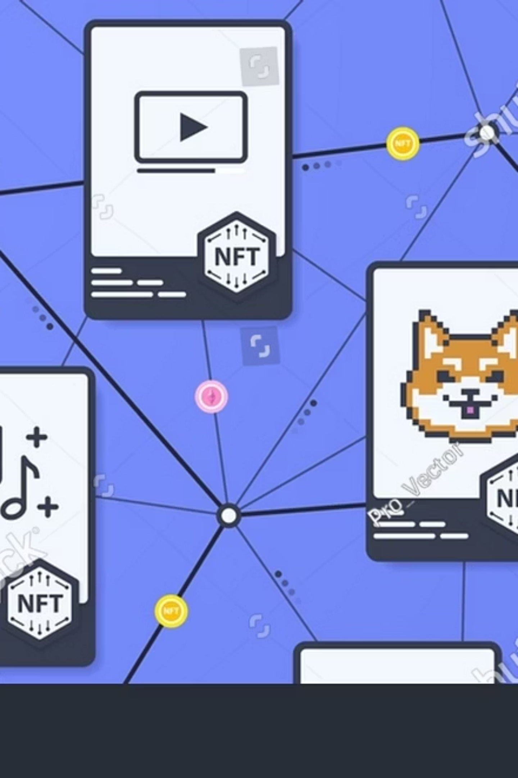
Cardano NFT Gift Card dApp
Transform traditional gift cards into personalized NFTs on the Cardano blockchain. Create beautiful, customizable gift cards loaded with ADA that recipients can redeem seamlessly.

Slide 2
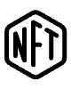
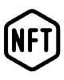


Revolutionary NFT Gift Experience
Decentralized
NFT-Powered
Built on Cardano blockchain ensuring security and transparency
Each gift card is a unique, collectible NFT
Customizable
ADA-Loaded
Personalized themes, messages, and designs
Load cards with real ADA value for recipients

Slide 3
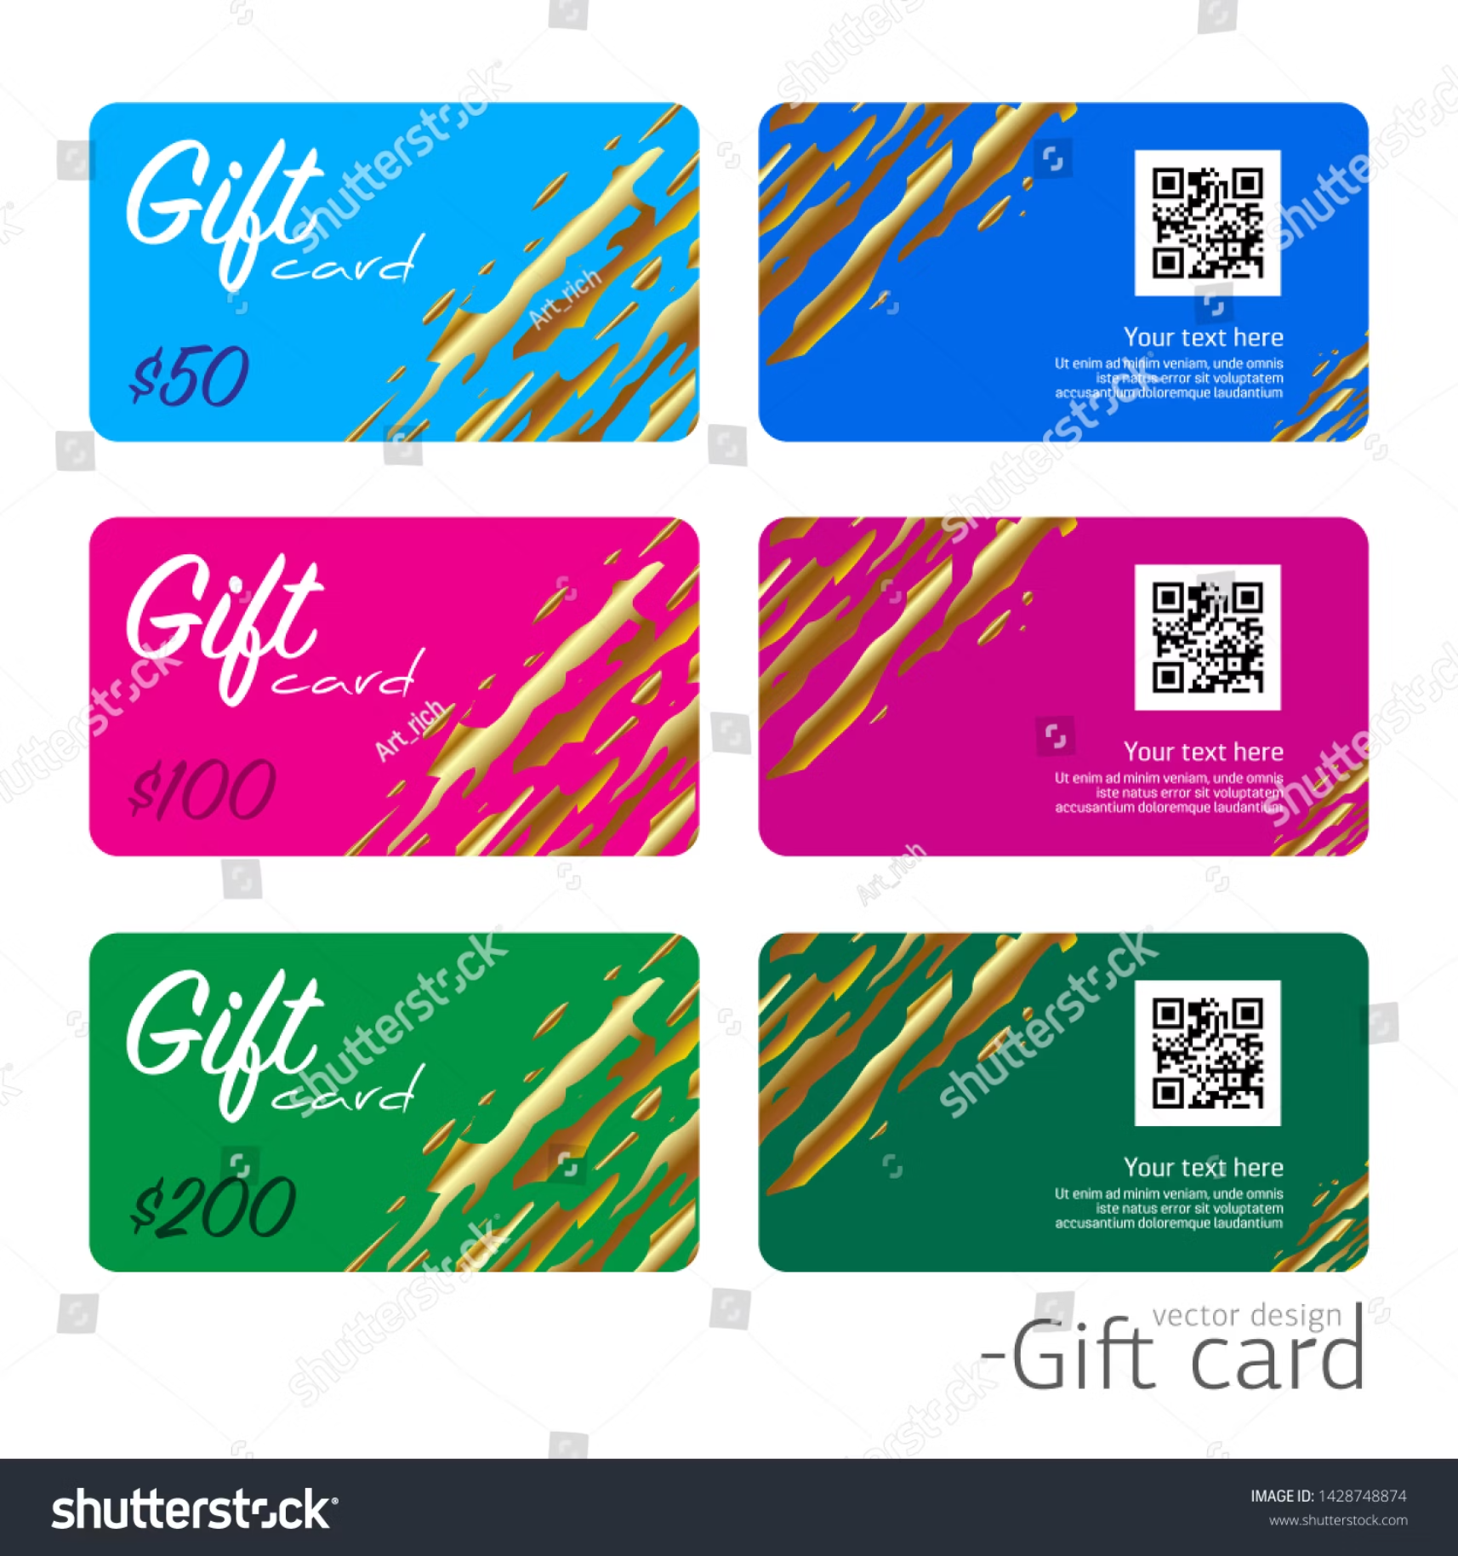
Beautiful Themes & Customization
6 Stunning Themes
Birthday celebrations
Holiday seasons
Anniversary milestones
General celebrations
Modern aesthetics
Minimal elegance
Plus 10 vibrant gradient backgrounds, 16 decorative elements, and custom personal messages to make each gift card truly unique.

Slide 4



Feature Highlights
Real-time Preview
Personal Messages
Live Updates
Watch your NFT design come to life as you create it with instant visual feedback and live updates.
Add heartfelt, custom messages to make your gift cards meaningful and memorable for recipients.
Real-time transaction status tracking and comprehensive gift card management dashboard.

Slide 5




Powerful Technology Stack
Smart Contract
Frontend
Aiken (Plutus V3) for secure, efficient blockchain operations
Next.js 15 with TypeScript for modern, type-safe development
Blockchain Integration
Styling
MeshJS for seamless Cardano wallet connectivity
TailwindCSS for responsive, beautiful UI components

Slide 6
Quick Setup Process
01
02
Clone Repository
Install Dependencies
Download the project and navigate to the directory
Run npm install to get all required packages
03
04
Compile Smart Contract
Launch Development
Use Aiken build to generate plutus.json and update constants
Start the dev server and connect your Cardano wallet

Slide 7





Creating Your First Gift Card
Connect Wallet
Link your Cardano wallet (Nami, Eternl, Flint)
Enter Details
Add recipient address and ADA amount (minimum 2 ADA)
Customize Design
Choose themes, colors, and personal messages
Create & Confirm
Sign transaction and wait for blockchain confirmation

Slide 8
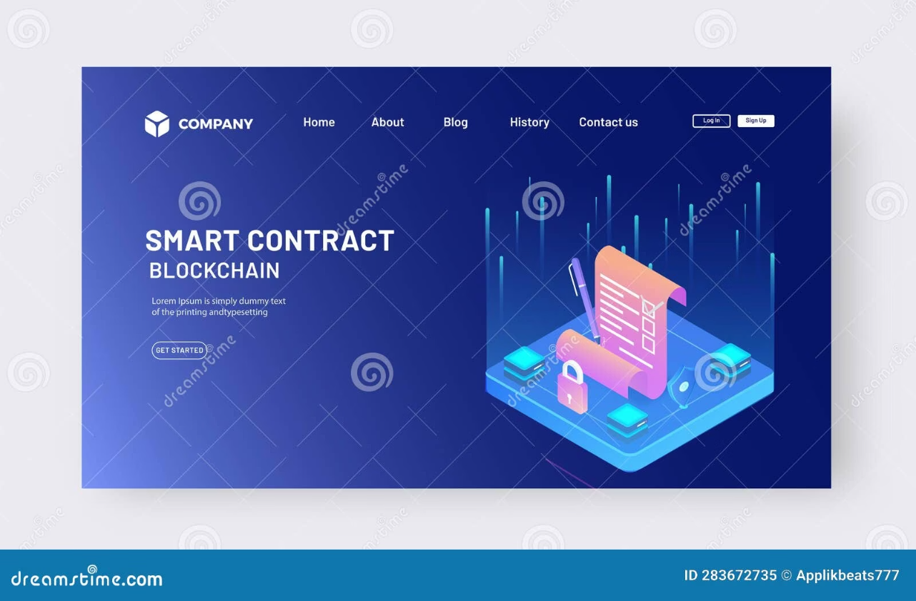

Smart Contract Security
Robust Validation Logic
The gift card smart contract ensures only designated recipients can redeem funds through cryptographic signature verification.
Datum Structure: Contains recipient's PubKeyHash for secure identification and fund protection.
Spend Condition: Transactions must be signed by the recipient specified in the datum, ensuring complete security.

Slide 9
Testing & Troubleshooting
Prerequisites
Common Issues
Test Scenarios
Preprod testnet ADA from faucet
Ensure wallet is on Preprod testnet
Create and redeem gift cards
Two wallet addresses for testing
Verify locked UTXOs
Node.js v18+ and Aiken v1.1.19+
Verify sufficient ADA for fees
Test error handling cases
Check recipient address validity

Slide 10

Ready to Transform Gifting?
Start Building Today
Join the revolution of decentralized gifting with our open-source NFT gift card dApp. Perfect for Web3 developers ready to create meaningful, secure, and beautiful gift experiences on Cardano.
"Happy gifting on Cardano! Transform traditional gift cards into memorable NFT experiences that recipients will treasure forever."

